Slide 1
Introduction to Stock Trader
John W. Alcorn
Director, Customer Technology Advisor
Cloud Journey Optimization Team
2025
Notes:
Thank you for taking time today to talk about how we can partner with you to power progress through continuous transformation.

Slide 2
Stock Trader sample for Kubernetes – Basic
Kubernetes (OCP, EKS, AKS, IKS, GKE, TKG)
Hyperscaler
Stock Quote
GET
API Manager
GET
Yahoo Finance
JDBC
Relational Database
GET
Browser
Trader (Java UI)
Portfolio
POST/GET
PUT/DELETE
Broker
Legend:
Blue: Open Liberty
Orange: Spring/Tomcat
Green: Dependency
This open-source application demonstrates how to build a cloud-native application out of microservices, which connect to services in the cloud. There is a GitHub org, at https://github.com/IBMStockTrader, which contains a repository per microservice, as well as a setup repository, an operator repository and a GitOps repository.
Here we see just the 4 mandatory microservices, and the mandatory managed services they depend upon. On the next slide, we’ll see additional optional pieces that demonstrate more advanced concepts, like caching, messaging, and notifications

Slide 3
Stock Trader sample for Kubernetes – with optional pieces
Solid Border:
Required
Dashed Border:
Optional
Kubernetes (OCP, EKS, AKS, IKS, GKE, TKG)
IBM Cloud
loopctl
Looper
Stock Quote
GET
API Connect
Jedis
Redis
GET
Yahoo Finance
GET
SET
DB2
Browser
Trader (Java UI)
Portfolio
JDBC
GET
Cloudant
IBM products are used as a historical example; all major hyperscalers and their managed services are supported
POST/GET
PUT/DELETE
GET, POST
Broker
Account
Legend:
Blue: Open Liberty
Red: Quarkus
Orange:
Spring/Tomcat
Purple: tWAS
Yellow: Node.js
Green: Dependency
GET
IBM
ODM
JMS
Put
Cash Account
IBM
MQ
POST
Watson Tone Analyzer
Kafka Send
Notification Service
MDB
onMessage
Notification (Slack)
IBM Event Streams
Messaging
POST
Slack / Teams
POST
IBM Cloud Functions
POST
Uses an Istio routing rule here
Kafka
Receive
GET
Trade History
GET
Mongo
Notification (Twitter)
POST
Twitter
POST
Twitter4J

Slide 4
Stock Trader using hyperscaler services – AWS
Selenium
EKS (using ECR)
AWS Services
Solid Border: Required
Dashed Border:
Optional
putObject
Browser
Cash Account
S3
Insert, Select,
Update, Delete
RDS (Aurora)
Trader
Gatling
Stock Quote
JDBC
Jedis
Exchange Rate Service
Elasti Cache
MSK
GET
SET
POST GET
GET
Publish
PUT DELETE
Mobile
Broker
Portfolio
Subscribe
Document DB
Watson Tone Analyzer
GET
POST
POST
Trade History
loopctl
Looper
Amazon
MQ
Yahoo Finance
JMS
In EC2
GET
GET
CouchDB
Account
GET
PUT
getStockQuote
POST
Slack / Teams
Legend:
Blue: Open Liberty
Orange: Spring
Red: Quarkus
Yellow: Node.js
Green: AWS Service
Purple: Other Service
Lambda
POST
MDB
onMessage
Notification Service
getLoyaltyLevel
API Gateway
Lambda
Notification
Lambda
Messaging
POST
postLoyaltyLevelToSlack
Twitter (𝕏)
Pick either the Slack or Twitter flavor
POST
Twitter4J
Notes:
We use PostgreSQL (JDBC) compatibility mode in Aurora in the Relational Database Service (RDS)
We use ActiveMQ (JMS) compatibility mode in Amazon MQ
We use Kafka (MicroProfile Reactive Messaging) with MSK
We use Redis (Jedis) via ElastiCache
We have 3 Lambda functions (exposed via the AWS API Gateway): getStockQuote, getLoyaltyLevel and postLoyaltyChangeToSlack

Slide 5



Stock Trader using hyperscaler services – Azure
MS SQL Server
Entra ID
Event Hubs
Mobile
Cosmos DB
Cash Account
Frankfurter
Yahoo Finance

Slide 6
Stock Trader on Azure – Securely “Integrate With” the mainframe in zCloud
Azure (us-east)
Mainframe (zCloud)
AKS
Gatling
KeyCloak (OIDC)
LDAP
Tivoli Directory Server
Portfolio
VPN
RACF
Issues JWT on successful login
JWT
JDBC
Browser
Azure Cache
GET
VPN
Db2
JWT
Trader (Java UI)
Stock Quote
Azure Cloud Functions
VSAM
GET
getStockQuote
Mobile
POST
GET
PUT
DELETE
CICS
JWT
Broker
Account
JWT
GET
getLoyaltyLevel
Legend:
Blue: Open Liberty
Orange: Spring
Red: Quarkus
Purple: Node.js
Brown: COBOL
Green: Dependency
Cash Account
JCL
GET, POST
CouchDB
PUT (debit, credit)
GET
APIM
REST
z/OS Connect
JWT
JWT
POST
DELETE
VPN
We also use Stock Trader to demonstrate a hybrid environment, where the business logic part of the app is in a public cloud, but the “system of record” is on the mainframe (in Kyndryl’s zCloud). We initially tested this with Red Hat’s KeyCloak (atop Quarkus) as our OIDC provider, but have also gotten Entra ID working for login (with 2FA).
Notes:
See here: https://github.com/IBMStockTrader/cash-account-cobol

Slide 7
The “umbrella” operator for the IBM Stock Trader sample
https://github.com/IBMStockTrader/stocktrader-operator
Wraps the helm chart at https://github.com/IBMStockTrader/stocktrader-helm
Described at https://medium.com/hybrid-cloud-engineering/the-ibm-stock-trader-operator-part-1-usage-9737a04b6848
Handles installation and configuration of the sample
No “day 2” operations – but does support altering the configuration and pushing that out
All microservices installed by single operator
The application as-a-whole is described by the CR you create from the CRD
No having to install each microservice separately
Can install the sample via a single “kubectl apply -f stocktrader.yaml” command
Prerequisite services are NOT installed by this operator
Helps configure connections to pre-provisioned prereq services
We have Terraform/OpenTofu scripts for installing and configuring the prereqs (for Azure, currently), at https://github.com/IBMStockTrader/stocktrader-setup

Slide 8
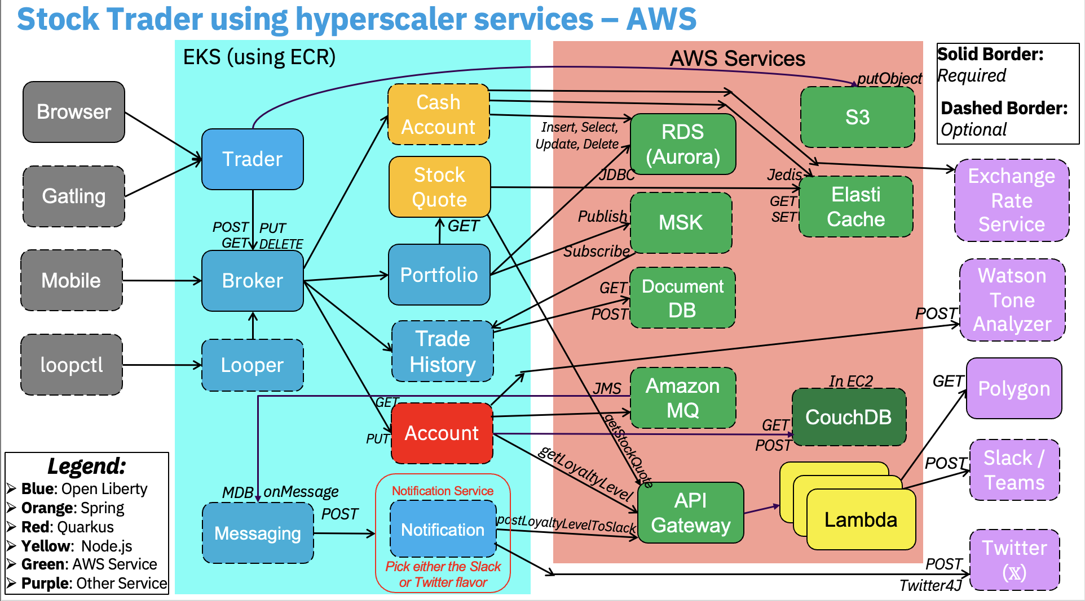
Stock Trader CI/CD – GitHub Actions as generic pipeline technology
We use this in
AWS & IBM Cloud
GitHub Action for GitOps repo
Could instead use Argo CD or Flux CD to drive updates to the cluster when the CR yaml is updated in the GitOps repo, instead of coding that into the GitHub Action for the stocktrader-gitops repo
Log in & apply CR yaml to desired Kube cluster
Operator creates requested Kube resources
Such as EKS
Such as Deployments, HPAs, etc.
Commit code in any microservice repository
Build code, tag & push image to container registry
Update CR yaml in GitOps repo with new tag
Such as portfolio
Such as ECR
stocktrader-gitops
GitHub Action per microservice

Slide 9
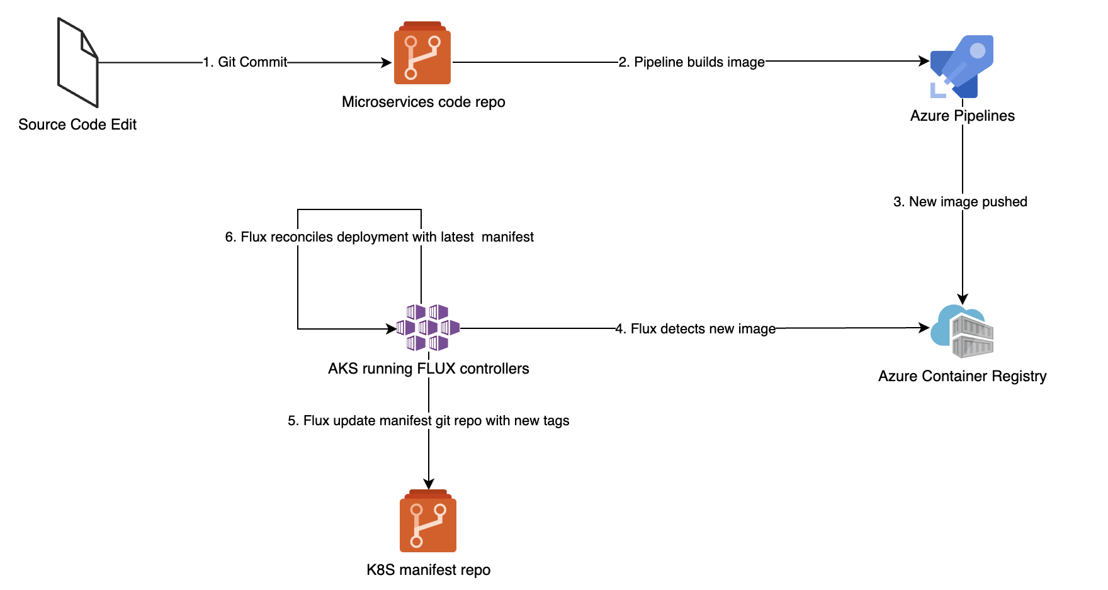
Stock Trader CI/CD – Azure Pipelines as vendor-specific technology
GitOps with Flux CD on AKS
Workflow sequence
Git repo for a microservice gets a commit
Microservices pipeline builds container with code changes
New image is pushed with new version tag to ACR
Flux image repo CRD detects new image in ACR and updates the K8s yaml manifests/Helm that use those images based on policy
The git repo with the cluster manifest is updated with commit
Flux git source repo CRD detects a new manifest for cluster and reconciles the state of cluster
Slide from Mark for Azure today - expect something similar on GCP.
Similar concepts to GHA approach used in IBM Cloud and AWS,
except uses Flux CD in place of an explicitly coded pipeline action to synch the updated CR yaml with the cluster

Slide 10
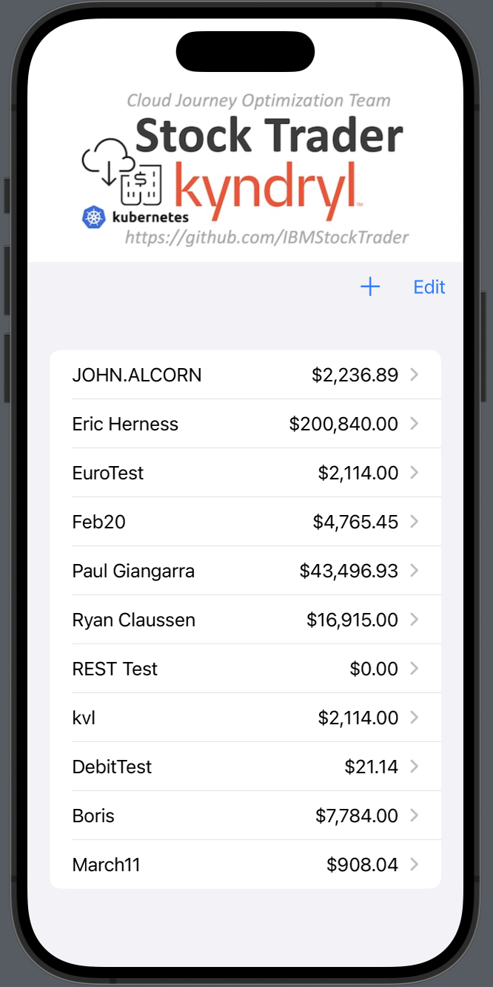
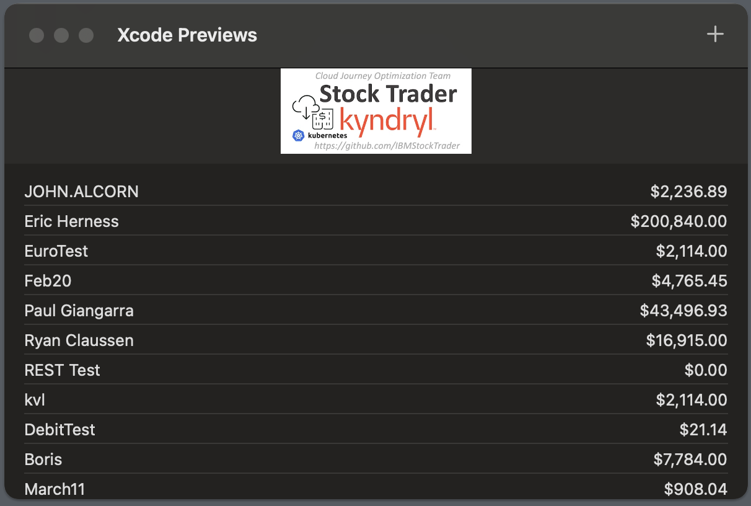
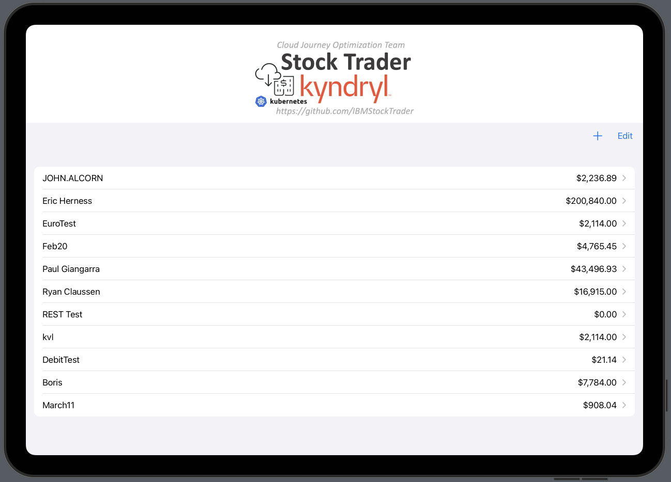
iOS (and MacOS) client to Stock Trader (iTrader)
We have a (still under construction) iTrader native client for Apple devices (iPhone, iPad & Mac), written in SwiftUI in the Xcode IDE
This client is an alternative to the Trader or Looper microservices, which like them makes direct REST calls to the Broker microservice
It does not currently have JWT enablement, so only works when the global.authType value in the CR yaml is set to “none” (meaning it sends a plain basic-auth id and password, like from curl -u)
Mac
iPhone
iPad

Slide 11
Important Topics to Consider Around Microservices and Kubernetes
Kubernetes-as-a-Service (hyperscaler managed) | Cross-zone HA
Container Registry (ECR, ACR, GCR, GHCR, Quay, etc.) | Cross-region DR
Secrets Management (Hashicorp Vault, Azure Key Vault, …) | HorizontalPodAutoscalers (policies for scale up/down)
SSL/TLS Certificate Management | Monitoring (scraping pods for metrics)
Service Mesh (mutual TLS, fault tolerance, blue/green depl) | Logging (routing pod logs to distributed logging console)
Synch (REST) vs Asynch (Kafka) interaction patterns | Tracing (routing pod trace records to Jaeger)
Operators (OLM, OperatorHub) for in-cluster service depl) | Vulnerability scanning of pod images
Helm Charts (simpler than operators, good for day 1) | Provisioning/Configuring via Infra-as-Code (Terraform, etc)
CI/CD Pipelines (per microservice, to update image in CR) | Serverless on Kubernetes (Knative)
GitOps (Argo CD, Flux CD) for applying CR yaml to cluster | CLIs (kubectl, oc, az, aws, eksctl, operator-sdk, etc.)
Best Practices for Kube apps (12-factor, etc) | Kyndryl services around Kubernetes (KCNS)
Pod Security (PSPs/PSAs) | Example applications (Stock Trader, etc)

Slide 12
Additional candidates to add to build pipeline
Start from a “curated” image in the production image registry (rather than Docker Hub)
The “curated” image could be customized to trust certs issued by the enterprise CA
Scan this starting point image (referenced in FROM line of Dockerfile) for newly reported vulnerabilities
Run a static code analysis on each microservice (such as via SonarQube)
Likely that many issues will be reported today, which we should report in GitHub and fix as we have time
Construct the key store and trust store during the build
Today we have private keys and certificates just open to the world in public Git repos
Or integrate with the hyperscaler’s key and certificate services
Run unit tests on each microservice (such as via JUnit)
Could start the Liberty server and test curling the context root (like Trader does in its Maven build)
grep the messages.log for any ERROR entries (and perhaps WARNINGs too)
Scan the microservice docker image that just got built for vulnerabilities
Some image registries may do this automatically for newly pushed images
Automatically perform a “loopctl.sh 1 1” integration test once CR yaml is deployed
Need to wait for pods to pass readiness check
Check federated logs for ERROR (and perhaps WARNING) entries in this time window
Run the cloud vendor’s security/compliance scan (like NIST) on app and its managed services

Slide 13
Load testing considerations
Need to enable health checks in the CR yaml (so work isn’t routed to a new pod until it is ready)
Ensure they aren’t causing undesired restarts (may need to tune timeouts in constrained environments)
Should start with 2 replicas per microservice, to avoid a single point of failure if Kube kills a pod
Ensure all is working under a “loopctl.sh 10 1000” run before proceeding further
Enable autoscaling in the CR yaml for each microservice
Tune the maximum replicas per microservice based on your available worker nodes
Tune the CPU threshold as desired (it may be difficult to cause scaling since most microservices do very little calculation – mostly they idle waiting on network calls to managed services to do stuff)
Might need to move from CPU thresholds to response time thresholds based on metrics)
Likely will need to learn to scale the managed services (databases, messaging, caching) as well, to handle requested concurrent workload and reduce the bottleneck imposed by each service
Ensure managed services are “local” to the region where the app lives – don’t egress to the public internet
For HA, deploy app to a Kube cluster with worker nodes spanning zones in an MZR, and use managed services that similarly span the MZR (use MZR-compliant storage, etc.)
Do longer, harder runs, like a “loopctl.sh 20 50000” and see how it behaves over hours or days
To do real fault tolerance (to declaratively specify retries, timeouts, rate limits, etc.), enable the service mesh for your Kube cluster/namespace (also enables mutual TLS for better security)
Enable chaos testing, like that will kill a pod, or even a node, and see if environment self heals
Might need the automatic retries from the service mesh above to not see failures from in-flight transactions)

Slide 14
Stock Trader Security & Compliance Scope
3-5 public end points (VMs, EKS Gateway)
ECS Image scan (Auto + On-demand)
AWS CodeBuild (future) for code level compliance
Build a posture management dashboard - AWS Security Hub
Regulatory Compliance: ( Over kill for Stock Trader)
IST 800 171 - Operational Best Practices (AWS Config)
NIST SP 800-171 - Controlled Unclassified Information? (AWS Audit Manager)
NIST 800-53 framework
PCI DSS - (If stocks were actually traded using any payments card)
NISP SP 800-207 - Zero Trust compliance

Slide 15
MicroProfile features used in IBM Stock Trader
Green means the feature is explicitly used
Yellow means the feature is not explicitly used, but out-of-the-box behavior is implicitly available
Red means no usage of the feature
The non-Liberty microservices, like the Node.js-based Tradr, the Spring/Tomcat-based CashAccount, and the tWAS-based Notification-Twitter, are not shown here since there is no MicroProfile available there
Messaging is the only traditional EJB-based microservice. It’s an MDB with no http endpoint
We usually use the fault tolerance features of the OpenShift Service Mesh (Red Hat’s productization of Istio) in lieu of MicroProfile Fault Tolerance
MicroProfile REST Client (with JSON-B) is used for all http/https calls between microservices
Trade History also uses mpReactiveMessaging

Slide 16
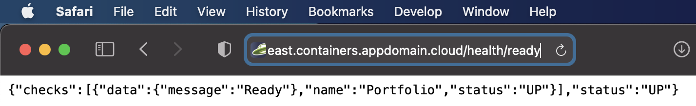
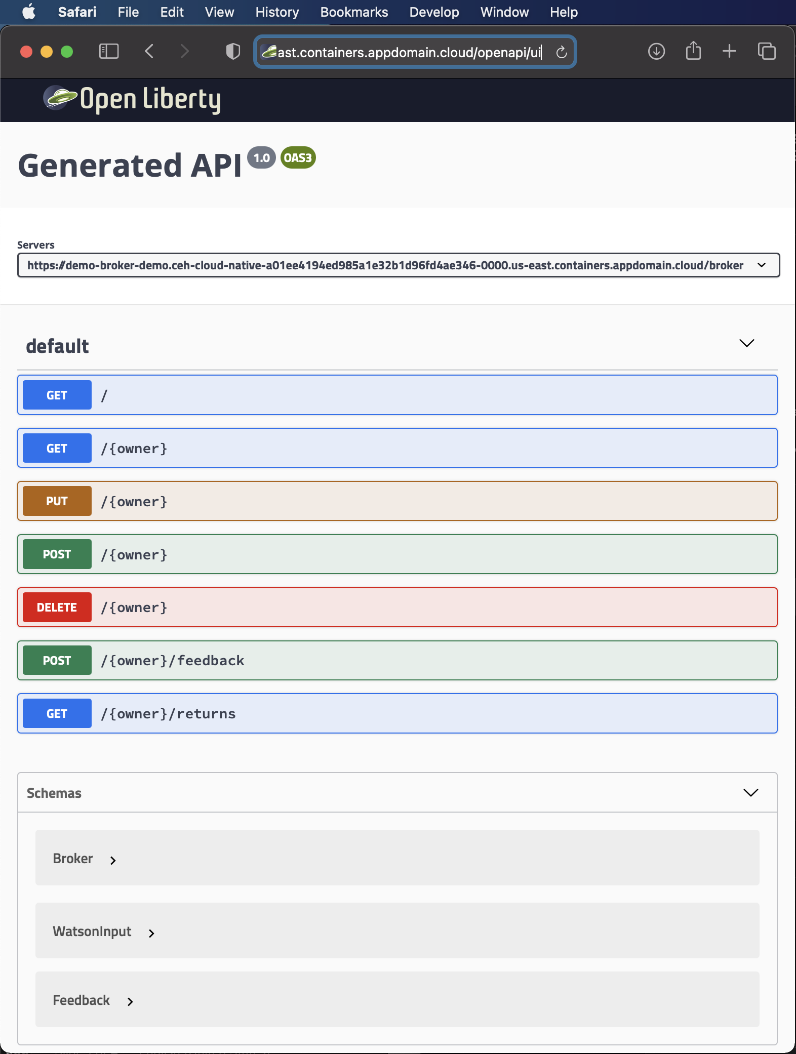
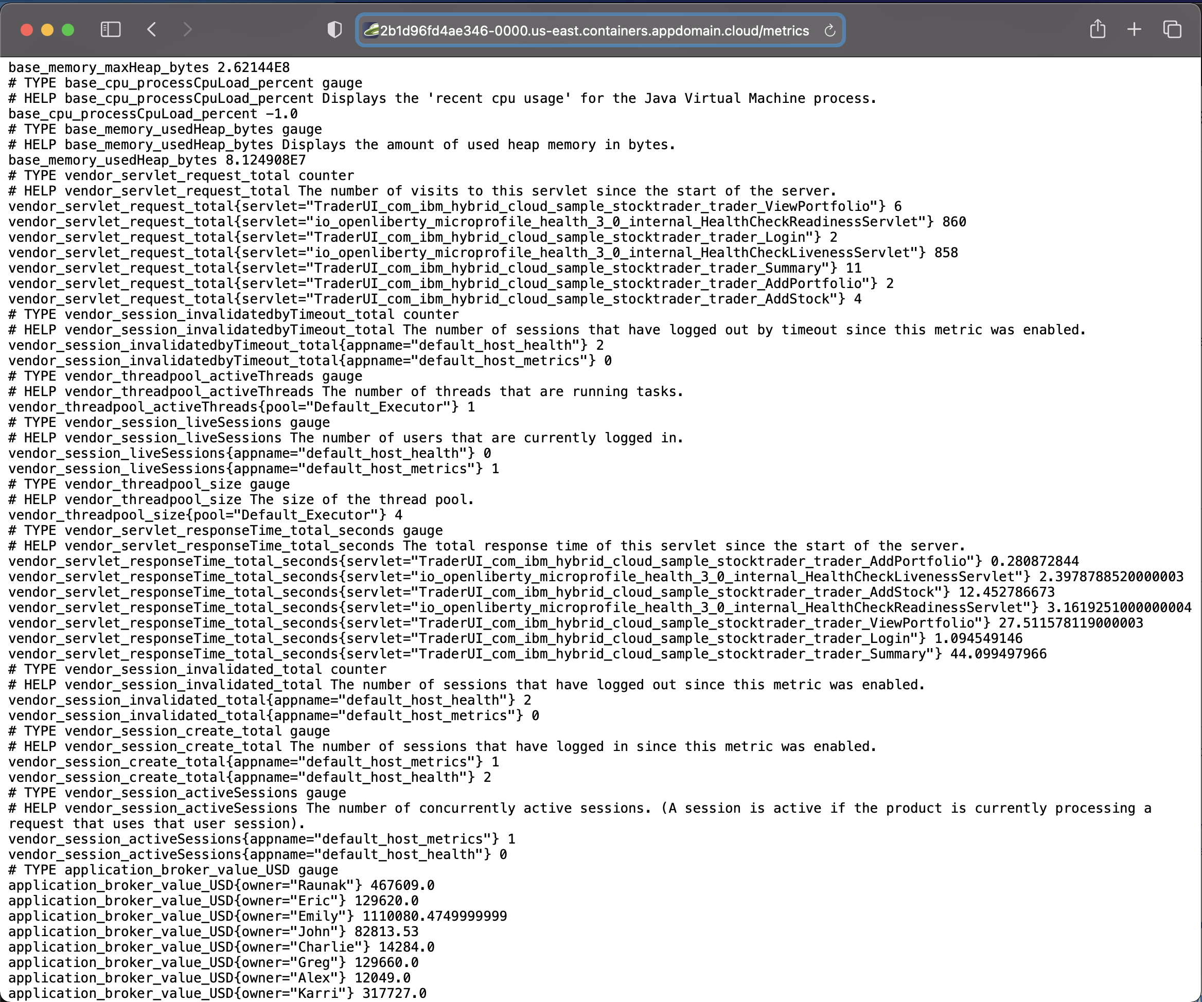
MicroProfile endpoints from IBM Stock Trader
Health:
OpenAPI:
Metrics:

Slide 17
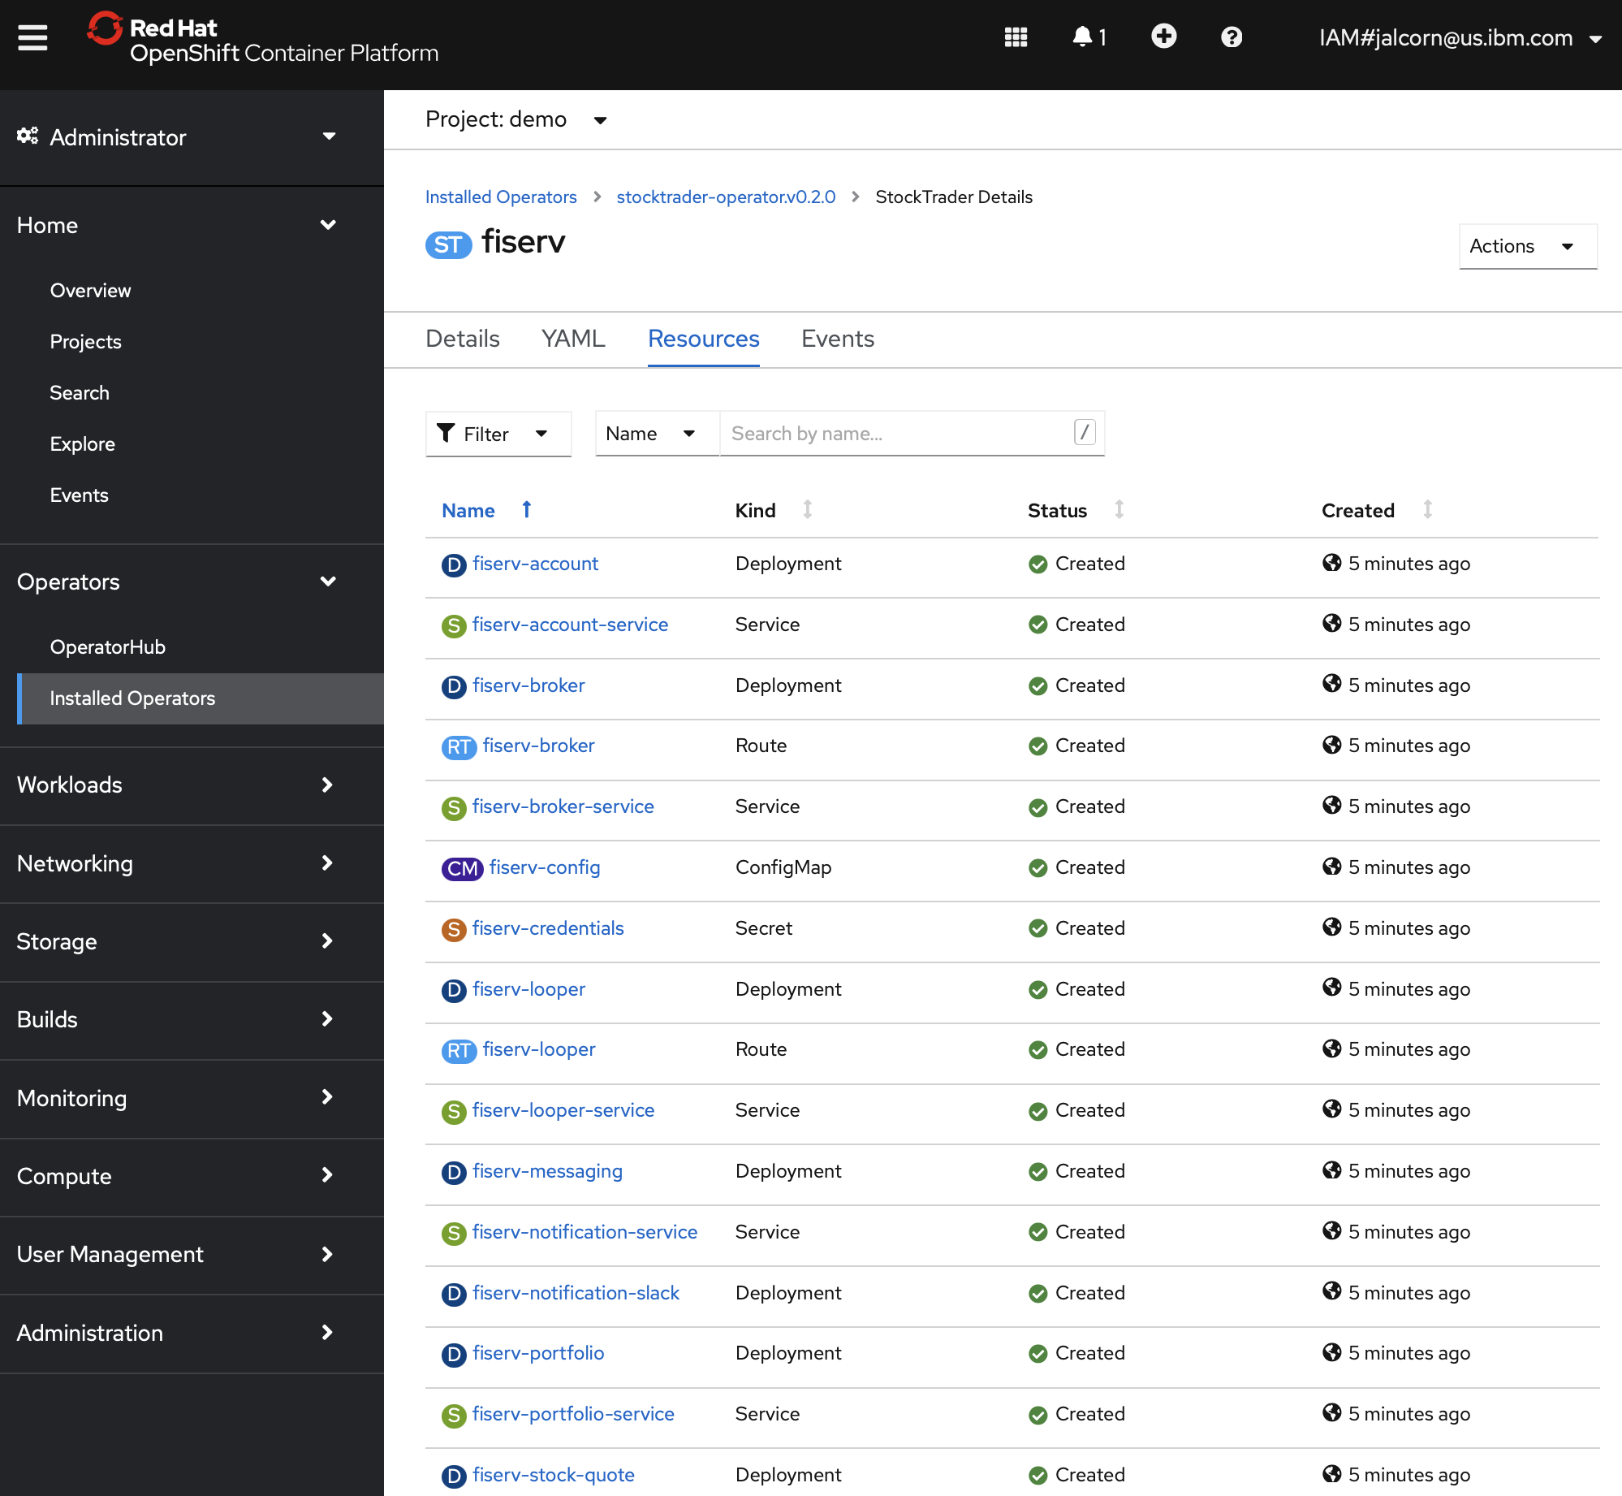
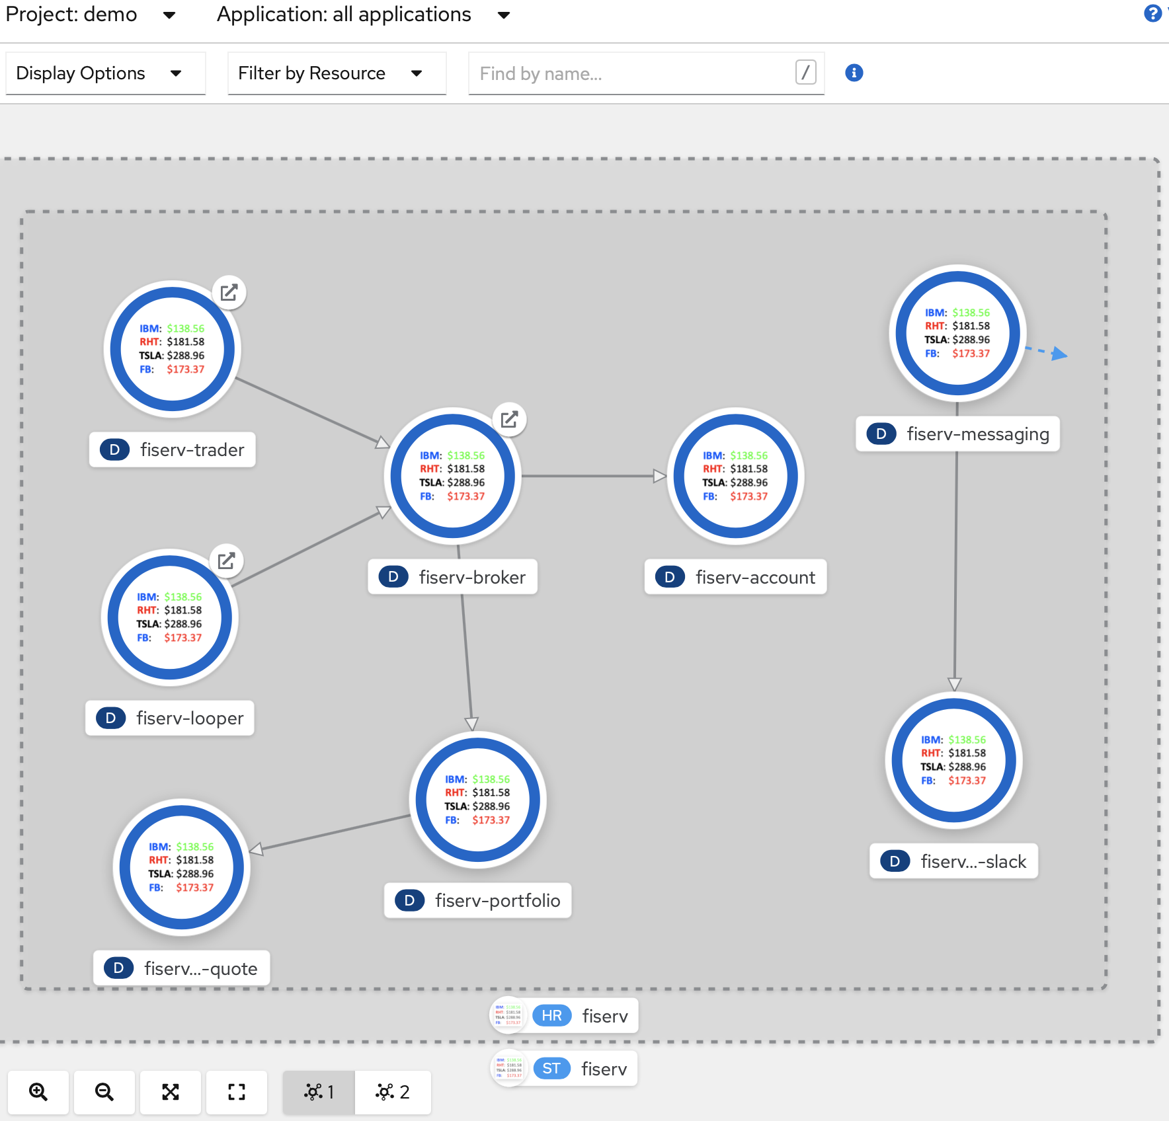
IBM Stock Trader microservices visualized in the OpenShift console

Slide 18
CQRS in IBM Stock Trader
Broker
GET /broker
javax.cache
Looper
Broker Query
RH Data Grid
GET /broker/{owner}
(or other JCache provider like Redis or Hazelcast)
(or other JDBC provider)
Trader
POST /broker/{owner}
Portfolio
Postgres
PUT /broker/{owner}
Kafka
Tradr
(Confluent or RH AMQ Streams)
DELETE /broker/{owner}
Account
Cloudant
CQRS would be optional (based on a boolean in the CRD, set via the form in the operator and passed as an env var to each pod). If not enabled, the GET calls would go to Portfolio and Account like usual, and nothing would get published to Kafka

Slide 19





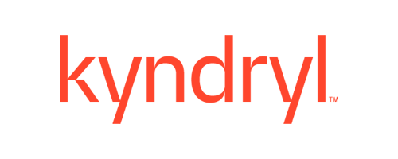
Source for Stock Trader helm chart/operator icon
Source for Stock Trader footer image
KD: $20.28
IBM: $183.76
MSFT: $406.02
AMZN: $168.94
GOOG: $145.38
AAPL: $186.44
https://github.com/IBMStockTrader

Slide 20
Approaches for HashiCorp Vault integration with microservices
Code directly to Vault in your microservice Java classes
Pros: Very secure – secrets not exposed in files or env vars
Cons: Must train developers to use proprietary code in every microservice, and vendor lock-in to HashiCorp as the secrets manager
Use the Vault injector to get an init container and sidecar
Pros: No impact to developers, and no vendor lock-in for microservices
Cons: Overhead of extra containers per pod, and risk of secrets getting disclosed to unauthorized parties that might see the files or env vars
*New*: Use the VaultConfigSource for MicroProfile Config
Pros: No impact to developers (if already using standard MicroProfile programming model of CDI injection of config properties), and no vendor lock-in. Also, no overhead of extra containers per pod, or disclosure risk
Cons: None!

